Slide 1
Tutorial Talk: Certified Deletion
James Bartusek
UC Berkeley

Slide 2
Outline
Basic scenario and applications
Recipe for constructions
Security
Certifiable deletion of programs

Slide 3
Outline
Basic scenario and applications
Recipe for constructions
Security
Certifiable deletion of programs

Slide 4


Certified Deletion: Cloud Storage
D

Slide 5




Certified Deletion: Cloud Storage
|
$$⟩$$
D
|
$$⟩$$
“Please delete my data”
D
Assumption: Malicious server cannot recover D from the encoding in polynomial time

Slide 6

Certified Deletion: Cloud Storage
|
$$⟩$$
D
|
$$⟩$$
“Please delete my data”
Assumption: Malicious server cannot recover D from the encoding in polynomial time

Slide 7
Certified Deletion: Cloud Storage
[Broadbent, Islam 20]
[Hiroka, Morimae, Nishimaki, Yamakawa 21]
Classically: [Garg, Goldwasser, Vasudevan 20]
|
$$⟩$$
D
|
$$⟩$$
“Please delete my data”
Assumption: Malicious server cannot recover D from the encoding in polynomial time
Goal #1: After deletion, the server won’t be able to recover D even given
Goal #2: After deletion, the server won’t be able to recover D even given unbounded time
Requirements: encryption + unclonability

Slide 8

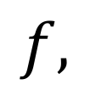
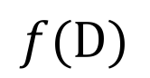
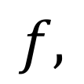
Certified Deletion: Delegation
|
$$⟩$$
$$f,$$
D
|
$$⟩$$
$$f,$$
D
$$f(D)$$

Slide 9
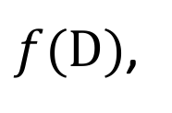
Certified Deletion: Delegation
|
$$⟩$$
$$f,$$
D
|
$$⟩$$
$$f,$$
$f(D)$,
$$f(D)$$

Slide 10

Certified Deletion: Delegation
[Broadbent, Islam 20]
[Poremba 23]
[B, Garg, Goyal, Khurana,
Malavolta, Raizes, Roberts 23]
|
$$⟩$$
$$f,$$
D
|
$$⟩$$
$$f,$$
$f(D)$,
$$f(D)$$
Server can compute and return $f(D)$ along with a proof that they erased all other information about $D$

Slide 11



Certified Deletion: Timed-Release Encryption
|
$$⟩$$
D
|
$$⟩$$
After time $T$:
D
D

Slide 12

Certified Deletion: Timed-Release Encryption
|
$$⟩$$
D
Before time $T$:
“Please delete my data”

Slide 13
Certified Deletion: Timed-Release Encryption
[Unruh 13]
[B, Khurana 23]
|
$$⟩$$
Before time $T$:
“Please delete my data”
Wills
Deposits

Slide 14
Outline
Basic scenario and applications
Recipe for constructions
Security
Certifiable deletion of programs

Slide 15
Approach
Modularize: think about the quantum information and crypto components separately
Take advantage of the uncertainty principle
We need states that can simultaneously encode information in two conjugate bases
One basis will encode plaintext information
The other will encode valid deletion certificates

Slide 16
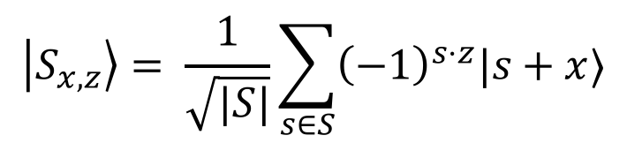
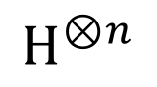
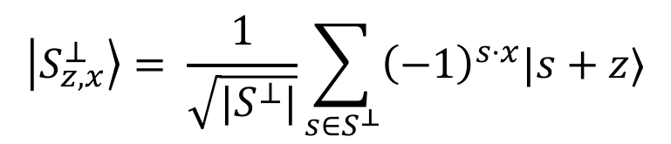
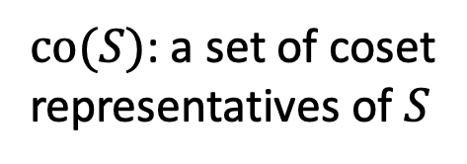


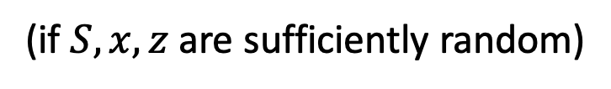
General Recipe
$co(S)$: a set of coset representatives of $S$
For a subspace $S⊂ 𝔽_{2}^{n}$ and vectors $x∈co\left(S\right),z∈co(S^{⊥})$, define
$$\left|S_{x,z}\right\rangle = \frac{1}{\sqrt{|S|}}\sum_{s∈S}{{\left(−1\right)}^{s⋅z}|s+x⟩}$$
Use $x$ to hide the plaintext
$$H^{⊗n}$$
$$\left|S_{z,x}^{⊥}\right\rangle = \frac{1}{\sqrt{|S^{⊥}|}}\sum_{s∈S^{⊥}}{{\left(−1\right)}^{s⋅x}|s+z⟩}$$
Use $z$ as certificate of deletion
Uncertainty principle: $𝒜(|S_{x,z}⟩)⇏(s∈S+x ,s^{′}∈S^{⊥}+z)$
(if $S,x,z$ are sufficiently random)

Slide 17
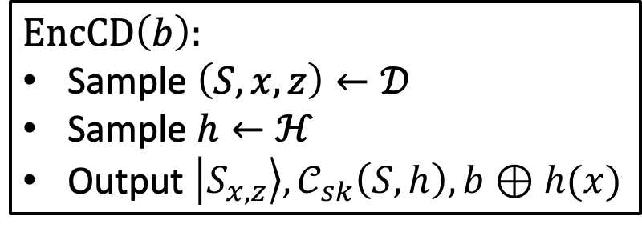
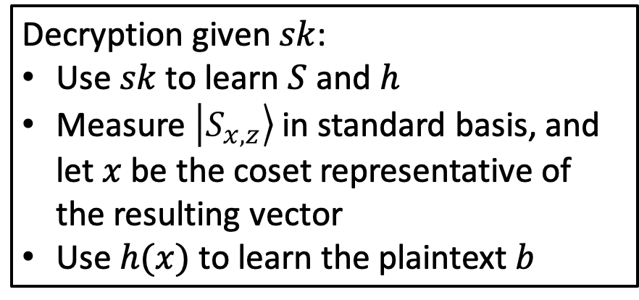
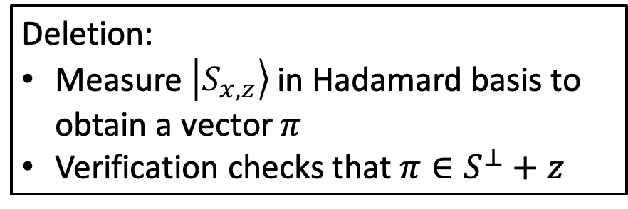
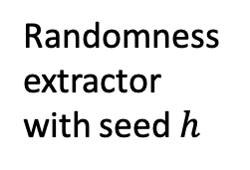
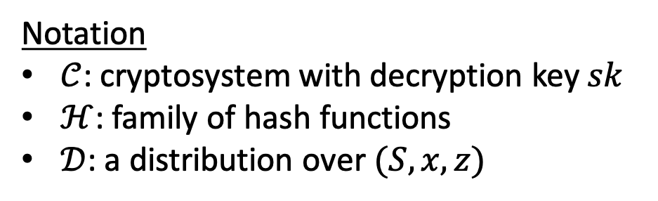
One-time pad
Public-key encryption
Commitment
Timed-release encryption
…
General Recipe
Notation
$𝒞$: cryptosystem with decryption key $sk$
$ℋ$: family of hash functions
$𝒟$: a distribution over $(S,x,z)$
Decryption given $sk$:
Use $sk$ to learn $S$ and $h$
Measure $\left|S_{x,z}\right\rangle$ in standard basis, and let $x$ be the coset representative of the resulting vector
Use $h(x)$ to learn the plaintext $b$
Randomness extractor with seed $h$
$EncCD\left(b\right):$
Sample $\left(S,x,z\right)←𝒟$
Sample $h←ℋ$
Output $\left|S_{x,z}\right\rangle ,𝒞_{sk}\left(S,h\right),b⊕h(x)$
Deletion:
Measure $\left|S_{x,z}\right\rangle$ in Hadamard basis to obtain a vector $π$
Verification checks that $π∈S^{⊥}+z$

Slide 18

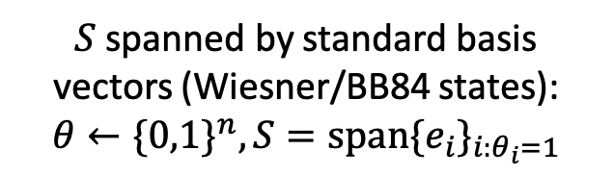
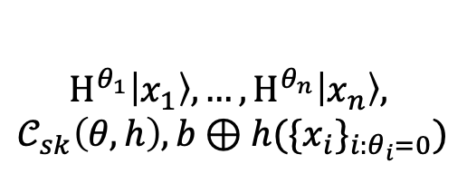
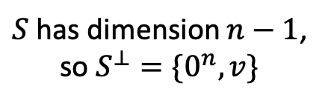
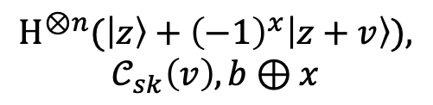
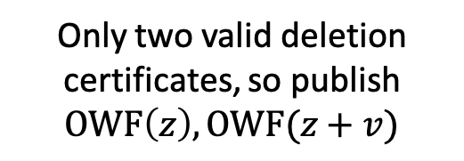

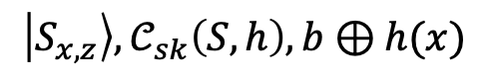

Instantiatiating the distribution over $S$
Optimize for…
Practicality
Publicly-Verifiable Deletion
Publicly-Verifiable Ciphertext
$S$ spanned by standard basis vectors (Wiesner/BB84 states): $θ←\{0,1\}^{n}, S=span\{e_{i}\}_{i:θ_{i}=1}$
$S$ has dimension $n−1$, so $S^{⊥}=\{0^{n},v\}$
$S$ uniform over all subspaces
$$H^{θ_{1}}\left|x_{1}\right\rangle ,…,H^{θ_{n}}\left|x_{n}\right\rangle ,$$
$$𝒞_{sk}\left(θ,h\right),b⊕h(\{x_{i}\}_{i:θ_{i}=0})$$
$$H^{⊗n}(\left|z\right\rangle +{\left(−1\right)}^{x}\left|z+v\right\rangle ),$$
$$𝒞_{sk}\left(v\right),b⊕x$$
$$\left|S_{x,z}\right\rangle ,𝒞_{sk}\left(S,h\right),b⊕h(x)$$
Only two valid deletion certificates, so publish $OWF\left(z\right),OWF(z+v)$
Secure even given oracle access to $S+x$
No entanglement required
[BI20]
[BKMPW23]
[BGGKMRR23]

Slide 19
Outline
Basic scenario and applications
Recipe for constructions
Security
Certifiable deletion of programs

Slide 20
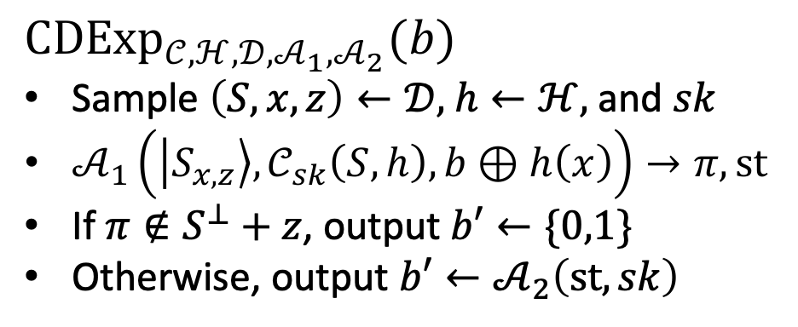

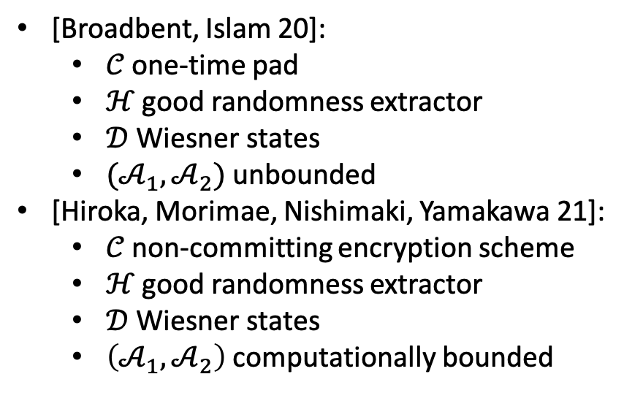
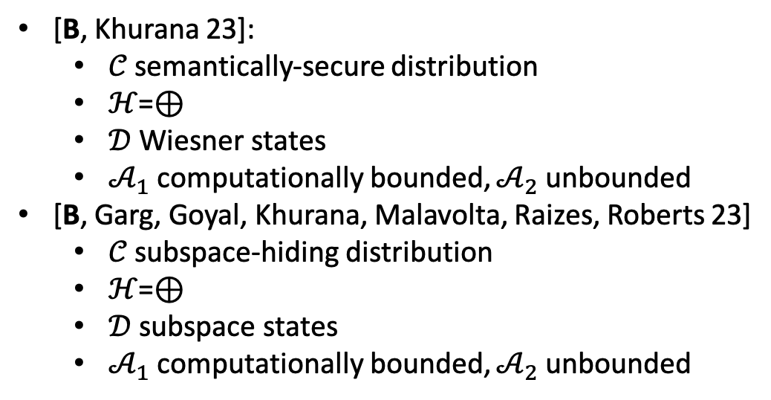
Security Game
${CDExp}_{𝒞,ℋ,𝒟,𝒜_{1},𝒜_{2}}(b)$
Sample $\left(S,x,z\right)←𝒟,$ $h←ℋ,$ and $sk$
$𝒜_{1}\left(\left|S_{x,z}\right\rangle ,𝒞_{sk}\left(S,h\right),b⊕h\left(x\right)\right)→π,st$
If $π∉S^{⊥}+z$, output $b′←\{0,1\}$
Otherwise, output $b′←𝒜_{2}\left(st,sk\right)$
Want: $\left|Pr\left[{CDExp}_{𝒞,ℋ,𝒟,𝒜_{1},𝒜_{2}}\left(0\right)=1\right]− Pr\left[{CDExp}_{𝒞,ℋ,𝒟,𝒜_{1},𝒜_{2}}\left(1\right)=1\right]\right|=negl$
Note: [Unruh 13] showed similar statement for a slightly different template supporting quantum certificates of deletion
History
[Broadbent, Islam 20]:
$𝒞$ one-time pad
$ℋ$ good randomness extractor
$𝒟$ Wiesner states
$(𝒜_{1},𝒜_{2})$ unbounded
[Hiroka, Morimae, Nishimaki, Yamakawa 21]:
$𝒞$ non-committing encryption scheme
$ℋ$ good randomness extractor
$𝒟$ Wiesner states
$\left(𝒜_{1},𝒜_{2}\right)$ computationally bounded
[B, Khurana 23]:
$𝒞$ semantically-secure distribution
$ℋ$=$⊕$
$𝒟$ Wiesner states
$𝒜_{1}$ computationally bounded, $𝒜_{2}$ unbounded
[B, Garg, Goyal, Khurana, Malavolta, Raizes, Roberts 23]
$𝒞$ subspace-hiding distribution
$ℋ$=$⊕$
$𝒟$ subspace states
$𝒜_{1}$ computationally bounded, $𝒜_{2}$ unbounded

Slide 21
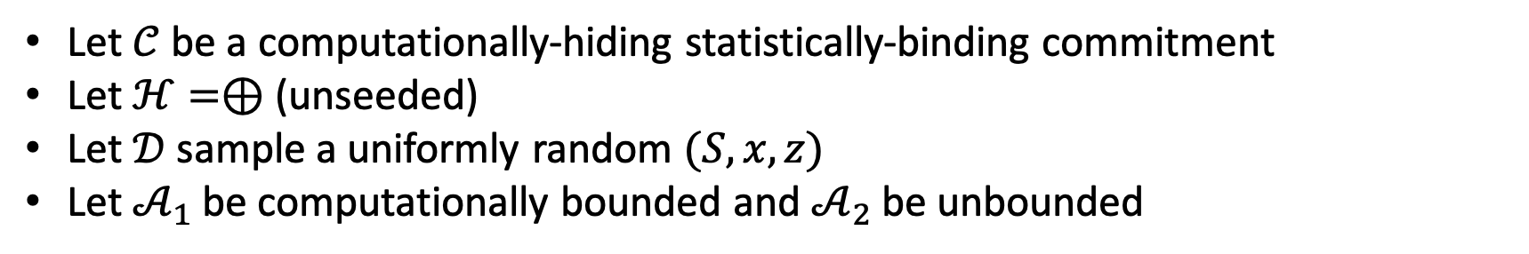
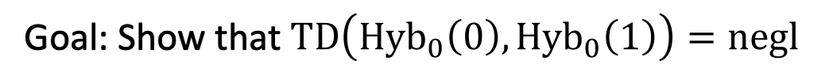
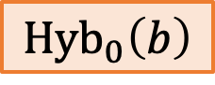

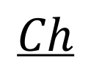
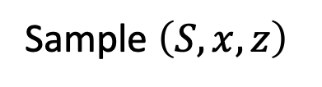
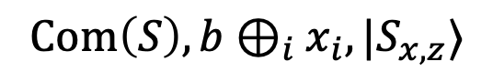
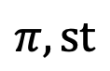
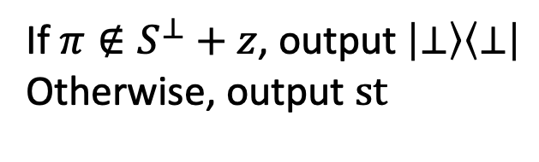
Example Proof
Let $𝒞$ be a computationally-hiding statistically-binding commitment
Let $ℋ=⊕$ (unseeded)
Let $𝒟$ sample a uniformly random $(S,x,z)$
Let $𝒜_{1}$ be computationally bounded and $𝒜_{2}$ be unbounded
$$𝒜$$
$${Hyb}_{0}\left(b\right)$$
$$Ch$$
Sample $\left(S,x,z\right)$
$$Com\left(S\right),b⊕_{i}x_{i},|S_{x,z}⟩$$
$$π,st$$
If $π∉S^{⊥}+z$, output $\left|⊥\right\rangle \left\langle ⊥\right|$
Otherwise, output $st$
Goal: Show that $TD\left({Hyb}_{0}\left(0\right),{Hyb}_{0}\left(1\right)\right)=negl$

Slide 22
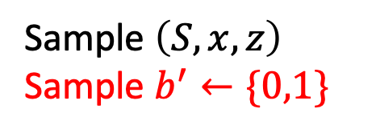
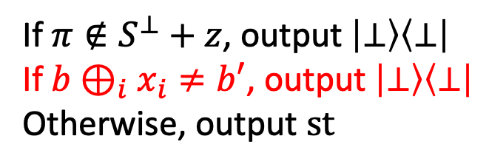
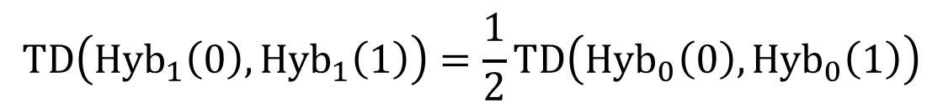

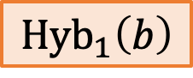
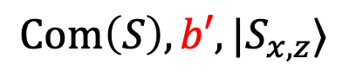
Example Proof
Hybrid 1: Delay the dependence of the experiment on $b$
$$TD\left({Hyb}_{1}\left(0\right),{Hyb}_{1}\left(1\right)\right)=\frac{1}{2}TD\left({Hyb}_{0}\left(0\right),{Hyb}_{0}\left(1\right)\right)$$
$$𝒜$$
$${Hyb}_{1}\left(b\right)$$
$$Ch$$
Sample $\left(S,x,z\right)$
Sample $b^{′}←\{0,1\}$
$$Com\left(S\right),b′,|S_{x,z}⟩$$
$$π,st$$
If $π∉S^{⊥}+z$, output $\left|⊥\right\rangle \left\langle ⊥\right|$
If $b⊕_{i}x_{i}≠b′$, output $\left|⊥\right\rangle \left\langle ⊥\right|$
Otherwise, output $st$
Remains to show that $x$ has a lot of conditional min-entropy

Slide 23
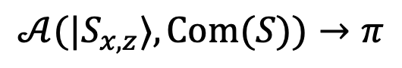
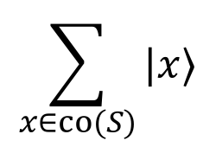
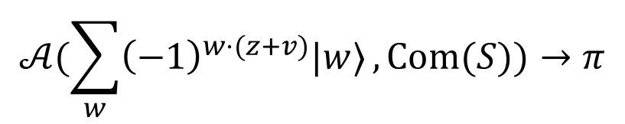
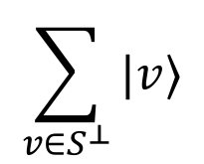
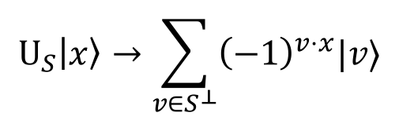
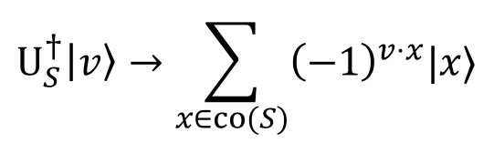



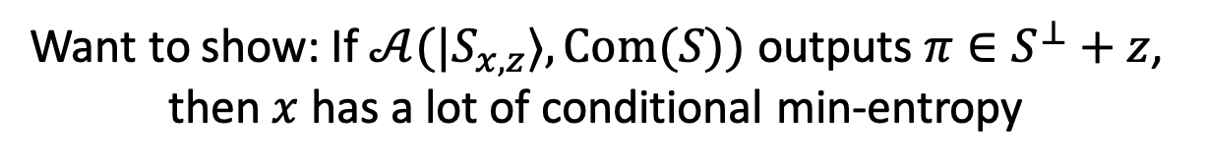
Example Proof
Want to show: If $𝒜(|S_{x,z}⟩, Com(S))$ outputs $π∈S^{⊥}+z$, then $x$ has a lot of conditional min-entropy
$$𝒜(|S_{x,z}⟩, Com(S))→π$$
Purify
$$U_{S}\left|x\right\rangle →\sum_{v∈S^{⊥}}{{\left(−1\right)}^{v⋅x}|v⟩}$$
$$\sum_{x∈co(S)}{|x⟩}$$
For $x∈co\left(S\right):$
$$𝒜(|S_{x,z}⟩, Com(S))→π$$
$$U_{S}$$
$$U_{S}^{†}\left|v\right\rangle →\sum_{x∈co(S)}{{\left(−1\right)}^{v⋅x}|x⟩}$$
For $v∈S^{⊥}:$
$$\sum_{v∈S^{⊥}}{|v⟩}$$
$$𝒜(\sum_{w}{{\left(−1\right)}^{w⋅(z+v)}|w⟩}, Com(S))→π$$

Slide 24
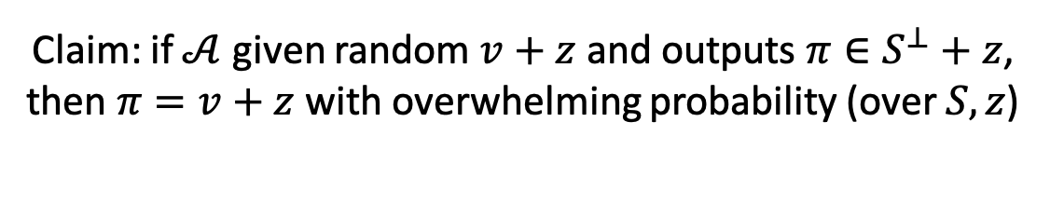
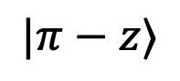
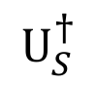
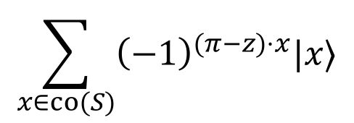
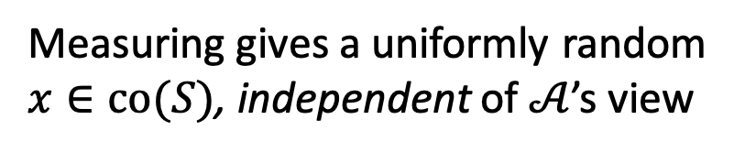
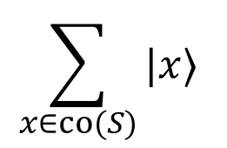
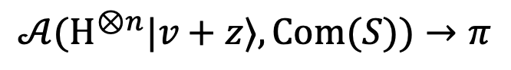
Example Proof
Want to show: If $𝒜(|S_{x,z}⟩, Com(S))$ outputs $π∈S^{⊥}+z$, then $x$ has a lot of conditional min-entropy
$$𝒜(|S_{x,z}⟩, Com(S))→π$$
Purify
$$U_{S}\left|x\right\rangle →\sum_{v∈S^{⊥}}{{\left(−1\right)}^{v⋅x}|v⟩}$$
$$\sum_{x∈co(S)}{|x⟩}$$
For $x∈co\left(S\right):$
$$𝒜(|S_{x,z}⟩, Com(S))→π$$
$$U_{S}$$
$$U_{S}^{†}\left|v\right\rangle →\sum_{x∈co(S)}{{\left(−1\right)}^{v⋅x}|x⟩}$$
For $v∈S^{⊥}:$
$$\sum_{v∈S^{⊥}}{|v⟩}$$
$$𝒜(H^{⊗n}|v+z⟩, Com(S))→π$$
Project
Claim: if $𝒜$ given random $v+z$ and outputs $π∈S^{⊥}+z$, then $π=v+z$with overwhelming probability (over $S,z$)
$$|π−z⟩$$
$$U_{S}^{†}$$
$$\sum_{x∈co(S)}{{\left(−1\right)}^{(π−z)⋅x}|x⟩}$$
Measuring gives a uniformly random $x∈co(S)$, independent of $𝒜$’s view

Slide 25
Outline
Basic scenario and applications
Recipe for constructions
Security
Certifiable deletion of programs

Slide 26
Plan
(Indistinguishability) obfuscation with certified deletion
Applications
Comparison with other notions
copy-protection
copy-detection
revocable crypto / key leasing
secure software leasing

Slide 27



Obfuscation with Certified Deletion
A “one-way” compiler that scrambles the description of a circuit while maintaining its functionality
Rough goal:
Encode a program $f$ into a deletable quantum state
Before deletion, the program is useful in some way, after deletion it is not
Candidate construction:
$$\left|S_{x,z}\right\rangle ,CObf\left(P[S,f⊕x]\right)$$
[BGGKMRR23]
$P\left[S,\tilde{f}\right]\left(y,v\right):$
Let $x$ be the coset of $S$ that $v$ belongs to
Let $f=\tilde{f}⊕x$
Output $f(y)$

Slide 28

Obfuscation with Certified Deletion
Rough goal:
Encode a program $f$ into a deletable quantum state
Before deletion, the program is useful in some way, after deletion it is not
Candidate construction:
$$\left|S_{x,z}\right\rangle ,CObf\left(P[S,f⊕x]\right)$$
[BGGKMRR23]
$P\left[S,\tilde{f}\right]\left(y,v\right):$
Let $x$ be the coset of $S$ that $v$ belongs to
Let $f=\tilde{f}⊕x$
Output $f(y)$
Correctness:
Given any input $y$, evaluate $Obf\left(P[S,f⊕x]\right)$ on $y$ and in superposition over $S+x$ to learn $f(y)$

Slide 29


Obfuscation with Certified Deletion
Rough goal:
Encode a program $f$ into a deletable quantum state
Before deletion, the program is useful in some way, after deletion it is not
Candidate construction:
$$\left|S_{x,z}\right\rangle ,CObf\left(P[S,f⊕x]\right)$$
[BGGKMRR23]
$P\left[S,\tilde{f}\right]\left(y,v\right):$
Let $x$ be the coset of $S$ that $v$ belongs to
Let $f=\tilde{f}⊕x$
Output $f(y)$
Issue with security:
By querying on different $v∉S+x$, can potentially learn evaluations of functions whose description is related to $f$

Slide 30
Obfuscation with Certified Deletion
Rough goal:
Encode a program $f$ into a deletable quantum state
Before deletion, the program is useful in some way, after deletion it is not
Candidate construction:
$$\left|S_{x,z}\right\rangle ,CObf\left(P[S,f⊕x]\right)$$
[BGGKMRR23]
$P\left[S,\tilde{f}\right]\left(y,v\right):$
Let $x$ be the coset of $S$ that $v$ belongs to
Let $f=\tilde{f}⊕x$
Output $f(y)$
Solution:
$P$ should only accept authentic vectors $v$ derived from the state $\left|S_{x,z}\right\rangle$

Slide 31



Obfuscation with Certified Deletion
Rough goal:
Encode a program $f$ into a deletable quantum state
Before deletion, the program is useful in some way, after deletion it is not
Candidate construction:
$$\left|S_{x,z}\right\rangle ,CObf\left(P[S,T,u,f⊕x]\right)$$
[BGGKMRR23]
$P\left[S,T,u,\tilde{f}\right]\left(y,v\right):$
Abort if $v∉T+u$
Let $x$ be the coset of $S$ that $v$ belongs to
Let $f=\tilde{f}⊕x$
Output $f(y)$
Solution:
$P$ should only accept authentic vectors $v$ derived from the state $\left|S_{x,z}\right\rangle$
Define authentic vectors via a random superspace $T+u⊃S+x$
Hard for the adversary to query on any authentic vector not in $S+x$

Slide 32

Obfuscation with Certified Deletion
If $CObf$ is modeled as a classical oracle:
Before deletion, evaluator can use the oracle to learn $f(y)$ for any $y$ of their choice
After deletion (outputting $v∈S^{⊥}+z$), the evaluator cannot learn anything else from the oracle even given unbounded queries
Candidate construction:
$$\left|S_{x,z}\right\rangle ,CObf\left(P[S,T,u,f⊕x]\right)$$
[BGGKMRR23]
$P\left[S,T,u,\tilde{f}\right]\left(y,v\right):$
Abort if $v∉T+u$
Let $x$ be the coset of $S$ that $v$ belongs to
Let $f=\tilde{f}⊕x$
Output $f(y)$
Solution:
$P$ should only accept authentic vectors $v$ derived from the state $\left|S_{x,z}\right\rangle$
Define authentic vectors via a random superspace $T+u⊃S+x$
Hard for the adversary to query on any authentic vector not in $S+x$

Slide 33

Without Oracles…
Indistinguishability obfuscation
For any two functionally equivalent circuits $C_{0},C_{1}, Obf\left(C_{0}\right)≈_{c}Obf(C_{1})$

Slide 34

Without Oracles…
Indistinguishability obfuscation with certified deletion
For any two functionally equivalent circuits $C_{0},C_{1}, Obf\left(C_{0}\right)≈_{c}Obf(C_{1})$, and after deletion $Obf\left(C_{0}\right)≈_{s}Obf(C_{1})$
Satisfied by a slightly modified construction
Seems like a weak guarantee, but (differing inputs) iO with CD are useful tools:
Two-message delegation with certified deletion
A generic compiler from encryption to encryption with revocable secret keys

Slide 35



Encryption with Revocable / Deletable Secret Keys
$Gen→pk,vk,|sk⟩$
$Enc\left(pk,m\right)→ct$
$Dec\left(|sk⟩,ct\right)→m$
$Del(|sk⟩)→cert$
$Ver\left(vk,cert\right)→⊤/⊥$
Deletion security: ciphertexts generated after successful deletion of $|sk⟩$ are semantically secure
Simple compiler: $\left|sk\right\rangle =iOCD(Dec(sk,⋅))$ [BGGMKRR23]
Gives publicly-verifiable revocation if iOCD is publicly verifiable
Privately-verifiable revocation from standard assumptions: [Kitagawa, Nishimaki 22], [Agarwal, Kitagawa, Nishimaki, Yamada, Yamakawa 23], [Ananth, Poremba, Vaikuntanathan 23]

Slide 36


Related Notions
Hard for the adversary to produce…
Copy Protection:
[Aaronson 09]
Publicly-Verifiable Deletion / Revocation:
[BGGKMRR23]
Privately-Verifiable Deletion / Revocation:
[KN22], [AKNYY23], [APV23]
Copy Detection / Infinite-Term Secure Software Leasing:
[Ananth, La Placa 21], [Aaronson, Liu, Liu, Zhandry, Zhang 22]
Finite-Term Secure Software Leasing:
[AL21]
“working” copy of a program
certificate derived from program
privately verifiable
publicly verifiable

Slide 37

Future Directions
Prove the security of ${CDExp}_{𝒞,ℋ,𝒟,𝒜_{1},𝒜_{2}}$ when
Encoding super-logarithmic bits per subspace state
$𝒞$ is any semantically-secure distribution and $ℋ$ is a good seeded randomness extractor
Robustness to noise (beyond one-time pad [BI20])
Publicly-verifiable revocation/deletion without post-quantum iO
More rigorous understanding of the relationship between unclonable primitives from previous slide ([Ananth, Kaleoglu, Liu 23])

Slide 38

Revisiting the Applications
Cloud Storage: $\left|S_{x,z}\right\rangle ,Enc\left(S\right),D⊕_{i}x_{i}$
Timed-release: $\left|S_{x,z}\right\rangle ,TRE\left(S\right),D⊕_{i}x_{i}$
Zero-knowledge:
Start with bit commitment scheme $\left|S_{x,z}\right\rangle ,Com\left(S\right),b⊕_{i}x_{i}$
Plug into Sigma protocol to obtain zero-knowledge proofs with certified everlasting hiding
Delegation: Use fully-homomorphic encryption? $\left|S_{x,z}\right\rangle ,FHE\left(S\right),D⊕_{i}x_{i}$

Slide 39






Delegation
Template from [Poremba 23]
D
$$\left|S_{x,z}\right\rangle ,\text{FHE}\left(S\right),D⊕_{i}x_{i},f$$
Coherently apply FHE evaluation
$$|FHE\left(f\left(D\right)\right)⟩$$
Decrypt coherently, measure $f(D)$, and uncompute
$$|FHE\left(f\left(D\right)\right)⟩$$
$$=s$$
Uncompute FHE evaluation, and measure $\left|S_{x,z}\right\rangle$in Hadamard basis to obtain $s∈S^{⊥}+z$
If Server is honest, this is a gentle measurement

Slide 40


Example Proof
Simplified version of proof from [BGGKMRR23]
Let $𝒞$ be a computationally-hiding statistically-binding commitment
Let $ℋ=⊕$
Let $𝒟$ sample a uniformly random $(S,x,z)$
Let $𝒜_{1}$ be computationally bounded and $𝒜_{2}$ be unbounded
$$𝒜$$
$$ExpCD\left(b\right)$$
$$Ch$$
Sample $\left(S,x,z\right)$
$$Com\left(S\right),b⊕_{i}x_{i},|S_{x,z}⟩$$
$$π,st$$
If $π∉S^{⊥}+z$, output $\left|⊥\right\rangle \left\langle ⊥\right|$
Otherwise, output $st$
Goal: Show that $TD\left(ExpCD\left(0\right),ExpCD\left(1\right)\right)=negl$

Slide 41








Example Proof
Simplified version of proof from [BGGKMRR23]
$$𝒜$$
$${Hyb}_{0}\left(b\right)$$
$$Ch$$
Sample $\left(S,x,z\right)$
$$Com\left(S\right),b⊕_{i}x_{i},|S_{x,z}⟩$$
$$π,st$$
If $π∉S^{⊥}+z$, output $\left|⊥\right\rangle \left\langle ⊥\right|$
Otherwise, output $st$
Tension #1: Want to show the output is statistically independent of the bit $b$, but $𝒜$’s input is a statistically-binding commitment to $b$
Tension #2: Have to invoke the computational hiding of $Com$ without moving to a computationally-indistinguishable hybrid
Approach: Define an efficiently-checkable predicate on the system which must hold by the computational hiding of $Com$
[Unruh 13]

Slide 42













Outline
$${Hyb}_{0}\left(0\right)$$
$${Hyb}_{0}\left(1\right)$$
Guess $b$
Guess $b$
$${Hyb}_{1}\left(0\right)$$
$${Hyb}_{1}\left(1\right)$$
Purify $x$
Purify $x$
$${Hyb}_{2}\left(0\right)$$
$${Hyb}_{2}\left(1\right)$$
Change of basis
Change of basis
$${Hyb}_{3}\left(0\right)$$
$${Hyb}_{3}\left(1\right)$$
Introduce projection
Introduce projection
$${Hyb}_{4}\left(0\right)$$
$${Hyb}_{4}\left(1\right)$$
Clearly close in trace distance

Slide 43
Example Proof
Simplified version of proof from [BGGKMRR23]
$$𝒜$$
$${Hyb}_{0}\left(b\right)$$
$$Ch$$
Sample $\left(S,x,z\right)$
$$Com\left(S\right),b⊕_{i}x_{i},|S_{x,z}⟩$$
$$π,st$$
If $π∉S^{⊥}+z$, output $\left|⊥\right\rangle \left\langle ⊥\right|$
Otherwise, output $st$

Slide 44








Example Proof
Simplified version of proof from [BGGKMRR23]
$$𝒜$$
$${Hyb}_{1}\left(b\right)$$
$$Ch$$
Sample $\left(S,x,z\right)$
Sample $b^{′}←\{0,1\}$
$$Com\left(S\right),b′,|S_{x,z}⟩$$
$$π,st$$
If $π∉S^{⊥}+z$, output $\left|⊥\right\rangle \left\langle ⊥\right|$
If $b⊕_{i}x_{i}≠b′$, output $\left|⊥\right\rangle \left\langle ⊥\right|$
Otherwise, output $st$
Hybrid 1: Delay the dependence of the experiment on $b$
$$TD\left({Hyb}_{1}\left(0\right),{Hyb}_{1}\left(1\right)\right)=\frac{1}{2}TD\left({Hyb}_{0}\left(0\right),{Hyb}_{0}\left(1\right)\right)$$

Slide 45







Example Proof
Simplified version of proof from [BGGKMRR23]
$$𝒜$$
$${Hyb}_{2}\left(b\right)$$
$$Ch$$
Sample $\left(S,z\right)$
Sample $b^{′}←\{0,1\}$
Prepare $\sum_{x∈co(S)}{{{\left|S_{x,z}\right\rangle }_{A}\left|x\right\rangle }_{X}}$
$$Com\left(S\right),b′,A$$
$$π,st$$
If $π∉S^{⊥}+z$, output $\left|⊥\right\rangle \left\langle ⊥\right|$
Measure register $X$ to obtain $x$
If $b⊕_{i}x_{i}≠b′$, output $\left|⊥\right\rangle \left\langle ⊥\right|$
Otherwise, output $st$
Hybrid 2: Purify the randomness of $x$

Slide 46









Example Proof
Simplified version of proof from [BGGKMRR23]
$$𝒜$$
$${Hyb}_{2}\left(b\right)$$
$$Ch$$
Sample $\left(S,z\right)$
Sample $b^{′}←\{0,1\}$
Prepare $\sum_{x∈co(S)}{{{\left|S_{x,z}\right\rangle }_{A}\left|x\right\rangle }_{X}}$
$$Com\left(S\right),b′,A$$
$$π,st$$
If $π∉S^{⊥}+z$, output $\left|⊥\right\rangle \left\langle ⊥\right|$
Measure register $X$ to obtain $x$
If $b⊕_{i}x_{i}≠b′$, output $\left|⊥\right\rangle \left\langle ⊥\right|$
Otherwise, output $st$
Must use the fact that $𝒜$ is computationally bounded
Intuition: In order for $𝒜$ to pass deletion, it must measure register $A$ in the Hadamard basis
Register $X$ will remain in uniform superposition over $x∈co(S)$, unentangled from $A$

Slide 47






Example Proof
Simplified version of proof from [BGGKMRR23]
$$𝒜$$
$${Hyb}_{2}\left(b\right)$$
$$Ch$$
Sample $\left(S,z\right)$
Sample $b^{′}←\{0,1\}$
Prepare $\sum_{x∈co(S)}{{{H^{⊗n}\left|S_{z,x}^{⊥}\right\rangle }_{A}\left|x\right\rangle }_{X}}$
$$Com\left(S\right),b′,A$$
$$π,st$$
If $π∉S^{⊥}+z$, output $\left|⊥\right\rangle \left\langle ⊥\right|$
Measure register $X$ to obtain $x$
If $b⊕_{i}x_{i}≠b′$, output $\left|⊥\right\rangle \left\langle ⊥\right|$
Otherwise, output $st$
Write register $A$ in the Hadamard basis

Slide 48





Example Proof
Simplified version of proof from [BGGKMRR23]
$$U_{S}\left|x\right\rangle →\sum_{v∈S^{⊥}}{{\left(−1\right)}^{v⋅x}|v⟩}$$
$$𝒜$$
$${Hyb}_{2}\left(b\right)$$
$$Ch$$
Sample $\left(S,z\right)$
Sample $b^{′}←\{0,1\}$
Prepare $\sum_{x∈co(S)}{{{H^{⊗n}\left|S_{z,x}^{⊥}\right\rangle }_{A}\left|x\right\rangle }_{X}}$
$$\sum_{x∈co(S)}{H^{⊗n}\left|S_{z,x}^{⊥}\right\rangle |x⟩}$$
$$Com\left(S\right),b′,A$$
$$π,st$$
$$U_{S}$$
If $π∉S^{⊥}+z$, output $\left|⊥\right\rangle \left\langle ⊥\right|$
Measure register $X$ to obtain $x$
If $b⊕_{i}x_{i}≠b′$, output $\left|⊥\right\rangle \left\langle ⊥\right|$
Otherwise, output $st$
$$\sum_{v∈S^{⊥}}{H^{⊗n}\left|v+z\right\rangle |v⟩}$$
$𝒜$ sees a superposition over $S^{⊥}+z$ with random phase $x$
This mixed state is equivalent to a mixture over vectors in $S^{⊥}+z$

Slide 49







Example Proof
Simplified version of proof from [BGGKMRR23]
$$U_{S}\left|x\right\rangle →\sum_{v∈S^{⊥}}{{\left(−1\right)}^{v⋅x}|v⟩}$$
$$𝒜$$
$${Hyb}_{3}\left(b\right)$$
$$Ch$$
Sample $\left(S,z\right)$
Sample $b^{′}←\{0,1\}$
Prepare $\sum_{v∈S^{⊥}}{{{H^{⊗n}\left|v+z\right\rangle }_{A}\left|v\right\rangle }_{X}}$
$$\sum_{x∈co(S)}{H^{⊗n}\left|S_{z,x}^{⊥}\right\rangle |x⟩}$$
$$Com\left(S\right),b′,A$$
$$π,st$$
$$U_{S}$$
If $π∉S^{⊥}+z$, output $\left|⊥\right\rangle \left\langle ⊥\right|$
Apply $U_{S}^{†}$to $X$ and then measure register $X$ to obtain $x$
If $b⊕_{i}x_{i}≠b′$, output $\left|⊥\right\rangle \left\langle ⊥\right|$
Otherwise, output $st$
$$\sum_{v∈S^{⊥}}{H^{⊗n}\left|v+z\right\rangle |v⟩}$$
Hyrid 3: Challenger applies change of basis $U_{S}$

Slide 50









Example Proof
Simplified version of proof from [BGGKMRR23]
$$U_{S}\left|x\right\rangle →\sum_{v∈S^{⊥}}{{\left(−1\right)}^{v⋅x}|v⟩}$$
$$𝒜$$
$${Hyb}_{4}\left(b\right)$$
$$Ch$$
Sample $\left(S,z\right)$
Sample $b^{′}←\{0,1\}$
Prepare $\sum_{v∈S^{⊥}}{{{H^{⊗n}\left|v+z\right\rangle }_{A}\left|v\right\rangle }_{X}}$
$$U_{S}^{†}\left|v\right\rangle →\sum_{x∈co(S)}{{\left(−1\right)}^{v⋅x}|x⟩}$$
$$Com\left(S\right),b′,A$$
$$π,st$$
If $π∉S^{⊥}+z$, output $\left|⊥\right\rangle \left\langle ⊥\right|$
Attempt to project register $X$ onto $|π−z⟩$, output $\left|⊥\right\rangle \left\langle ⊥\right|$ if fails
Apply $U_{S}^{†}$to $X$ and then measure register $X$ to obtain $x$
If $b⊕_{i}x_{i}≠b′$, output $\left|⊥\right\rangle \left\langle ⊥\right|$
Otherwise, output $st$
$$TD\left({Hyb}_{4}\left(0\right),{Hyb}_{4}\left(1\right)\right)=negl$$
Hybrid 4: Introduce projection on register $X$

Slide 51
Outline
$${Hyb}_{0}\left(0\right)$$
$${Hyb}_{0}\left(1\right)$$
Guess $b$
Guess $b$
$${Hyb}_{1}\left(0\right)$$
$${Hyb}_{1}\left(1\right)$$
Purify $x$
Purify $x$
$${Hyb}_{2}\left(0\right)$$
$${Hyb}_{2}\left(1\right)$$
Change of basis
Change of basis
$${Hyb}_{3}\left(0\right)$$
$${Hyb}_{3}\left(1\right)$$
Introduce projection
Introduce projection
$${Hyb}_{4}\left(0\right)$$
$${Hyb}_{4}\left(1\right)$$
Clearly close in trace distance

Slide 52

Example Proof
Simplified version of proof from [BGGKMRR23]
To complete the proof, show that for $b∈\{0,1\}$, $TD\left({Hyb}_{3}\left(b\right),{Hyb}_{4}\left(b\right)\right)=negl$
Suffices to show that $𝒜$ has negligible probability of winning the following game:
Sample $S$, $z←co(S^{⊥})$, $v←S^{⊥}$
$𝒜\left(Com\left(S\right),v+z\right)→π$
$𝒜$ wins if $π∈S^{⊥}+z$ but $π≠v+z$

Slide 53


Example Proof
Simplified version of proof from [BGGKMRR23]
To complete the proof, show that for $b∈\{0,1\}$, $TD\left({Hyb}_{3}\left(b\right),{Hyb}_{4}\left(b\right)\right)=negl$
Suffices to show that $𝒜$ has negligible probability of winning the following game:
Sample $S$, $z←co(S^{⊥})$, $v←S^{⊥}$
$𝒜\left(Com\left(0\right),v+z\right)→π$
$𝒜$ wins if $π∈S^{⊥}+z$ but $π≠v+z$
Computational hiding of $Com$

Slide 54

Example Proof
Simplified version of proof from [BGGKMRR23]
To complete the proof, show that for $b∈\{0,1\}$, $TD\left({Hyb}_{3}\left(b\right),{Hyb}_{4}\left(b\right)\right)=negl$
Suffices to show that $𝒜$ has negligible probability of winning the following game:
Sample $S$, $z←co(S^{⊥})$, $v←S^{⊥}$
$𝒜\left(Com\left(0\right),v+z\right)→π$
$𝒜$ wins if $π∈S^{⊥}+z$ but $π≠v+z$
Negligible due to the randomness of $S$

Slide 55
Revisiting the Applications
Cloud Storage: $\left|S_{x,z}\right\rangle ,Enc\left(S\right),D⊕_{i}x_{i}$
Timed-release: $\left|S_{x,z}\right\rangle ,TRE\left(S\right),D⊕_{i}x_{i}$
Zero-knowledge:
Start with bit commitment scheme $\left|S_{x,z}\right\rangle ,Com\left(S\right),b⊕_{i}x_{i}$
Plug into Sigma protocol to obtain zero-knowledge proofs with certified everlasting hiding
Delegation: Use fully-homomorphic encryption? $\left|S_{x,z}\right\rangle ,FHE\left(S\right),D⊕_{i}x_{i}$

Slide 56



Delegation
Template from [Poremba 23]
Security against malicious servers: [BGGKMRR23]
D
$$\left|S_{x,z}\right\rangle ,\text{FHE}\left(S\right),D⊕_{i}x_{i},f$$
Coherently apply FHE evaluation
$$|FHE\left(f\left(D\right)\right)⟩$$
Decrypt coherently, measure $f(D)$, and rewind
$$|FHE\left(f\left(D\right)\right)⟩$$
$$=π$$
Uncompute FHE evaluation, and measure $\left|S_{x,z}\right\rangle$in Hadamard basis to obtain $π∈S^{⊥}+z$
If Server is honest, this does not disturb the state

Slide 57

Certified Deletion: Zero-Knowledge Proofs
Prover
Verifier
$$π$$
w

Slide 58

Certified Deletion: Zero-Knowledge Proofs
[Hiroka, Morimae, Nishimaki, Yamakawa 22]
Prover
Verifier
$$π$$
w
Certified everlasting zero-knowledge: Verifier has statistically no information about the witness $w$ after producing

